Slide 1


Where social policy and planning meet
Land policy for the provision of age-appropriate housing in densification projects
Josje Bouwmeester
Deniz Ay
Notes:
Fourth-year doctoral student at the university of Bern. How planning pracitces in NL and CH are becoming more and more entrepreneurial to achieve densification objectives, and how does this affect housing affordability.
Age-appropriate housing: side project with my colleague Deniz Ay
This paper: land policy for provision of age-appropriate housing -> In the Netherlands. Interesting case, as hopefully becomes clear in the presentation.

Slide 2
% of population of 65 years or older
Notes:
Why is it relevant to look at the provision of age appropriate housing?
Growing percentage of the world population is 65 years or older
Aging society: US rapidly increasing, and will continue to do so.
NL expected to reach highest points in 2040, when over 25% will be 65 years or older

Slide 3


Notes:
These demographic changes require a response in housing supply, as older people need to find a place to live.

Slide 4
Growing care crisis
Informal care provision
Budget cuts
Labor shortages
Notes:
This is especially the care because of the growing care crisis. Driving forces of care crisis:
2-income households norm = less time for informal care provision (especially by women)
Budget cuts in State spending as the traditional welfare state is being reduced
Labor shortages in care sector

Slide 5
Aging-in-place: Definition
“Aging-in-place is about the opportunity for older people to remain in their own home for as long as possible without having to move to a long-term care facility”
- Pani-Harreman et al. (2020)
Notes:
In response to these demograpic and socio-economic trends, many governments in europe have shifted towards a strategy called aging in place, which basically means elderly should age in their own communities for as long as possible.
Avoiding that they need to move to an institutional care facility

Slide 6


Aging-in-place: Densification
Notes:
Like I already mentioned: this requires a change in the housing supply.
Small apartments, accessbility, close to facilities and public transport.
And densification , which is another important objective in the European policy context, provides an excellent opportunity to realize this.

Slide 7
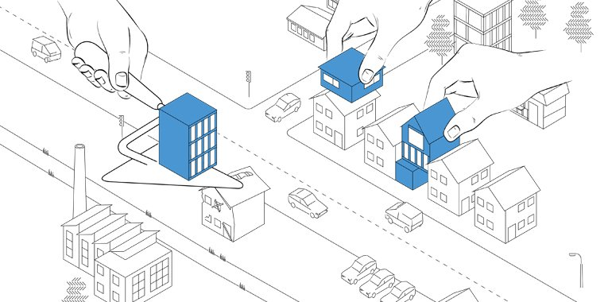
Making land available
Notes:
More difficult than greenfield expansions, because of the complex web of rights and interests. Planners need to deal with landowners, who have a vetorights because of their property rights.
This means that a big challenge for planners is to make land available for age-appropriate housing
> How can local planning authorities steer densification processes to facilitate aging in place?

Slide 8
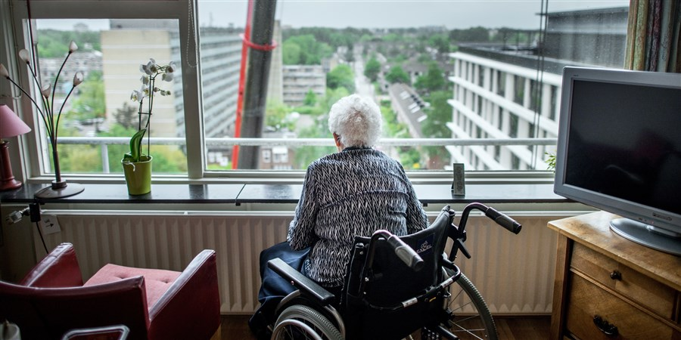
A bit of Dutch context…
Elderly care = housing issue
State and non-profit housing corporations
Notes:
Historically high percentage of insitutionalized elderly people.
Elderly care has always been seen as a housing issue. After WWII, many elderly homes and care homes were constructed in collaboration between State and housing corporations.
Citizens were all mandatory insured

Slide 9
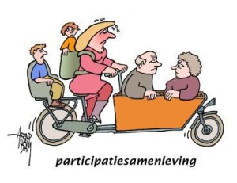
A bit of Dutch context…
“Participation society”
Decentralization
Notes:
From the 80s, 90s onward: Budget cuts
And in 2015:
Participation society: care should become our own responsibility again, not funded by the state
care responsibilities were decentralized to the municipal level: no additional funding

Slide 10
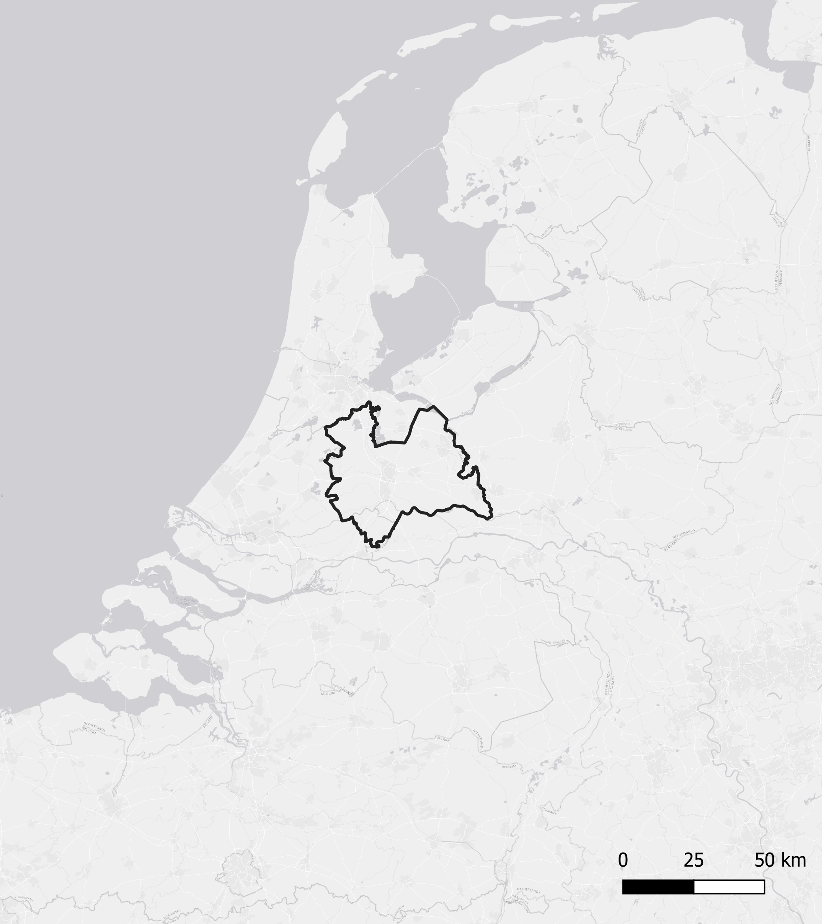
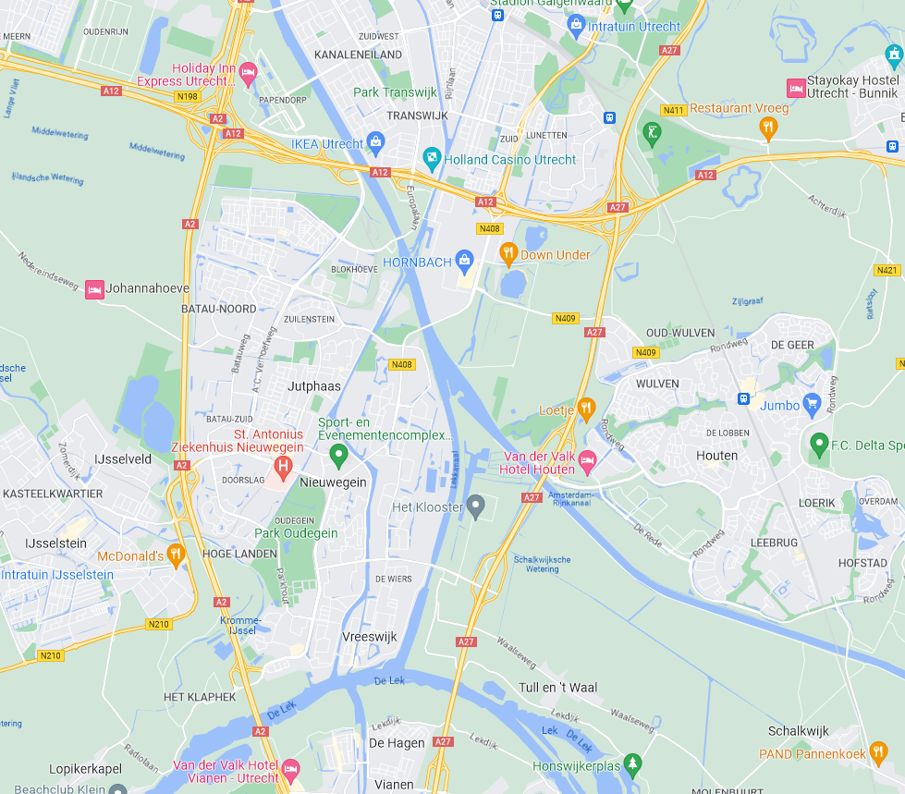
Case study Nieuwegein (NL)
Notes:
Expanded a lot in the 70s
Young families -> now aging
Due to position of Nieuwegein -> needs to be implemented through densification

Slide 11
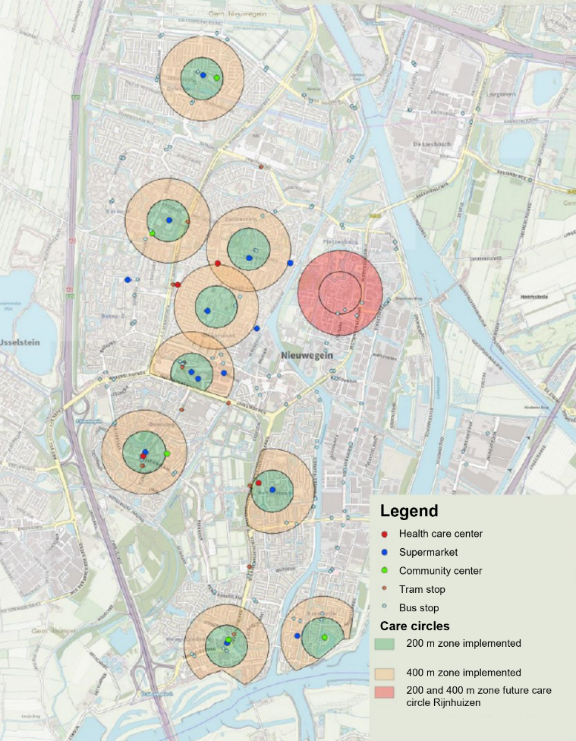
Care circles
Notes:
One of the first municipalities to combine care and housing policy
Concretly, the vision included these care circles, of 400 m around care facilities, supermarkets, and public transport,, where the municipality would like to see age appropriate housing realized. And this comes with additional requirements mostly in relation to the accessibility of the apartments.
The problem of the care circle is that it is merely a municipal vision, it is in no way binding to landowners.
And Dutch municipalities are not allowed to put higher criteria in the land use plan than what the requirements that are stipulated in the national building code.
This means that planning authorities cannot oblige landowners to construct age-appropriate housing

Slide 12
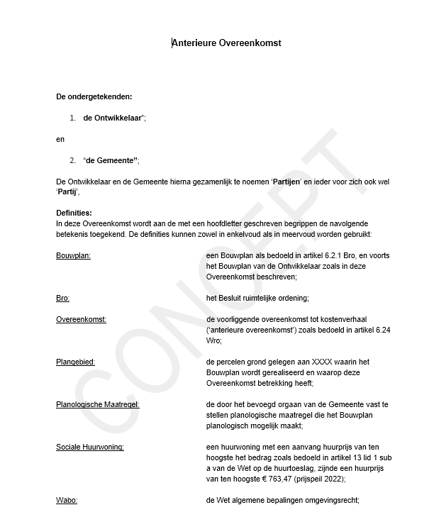

Private law contracts
Notes:
So, instead of working with a traditional land use plan, the municipality works with private law contracts. When a developer wants to redevelop their plot, they need to request an exemption permit because the project does not fit in with the old land use plan. To receive an exemption permit, they need to sign a private law contract with the public authorities.
Flexibility : extra legal requirements: accessibility
Result: age-appropriate housing is constructed in care circles

Slide 13
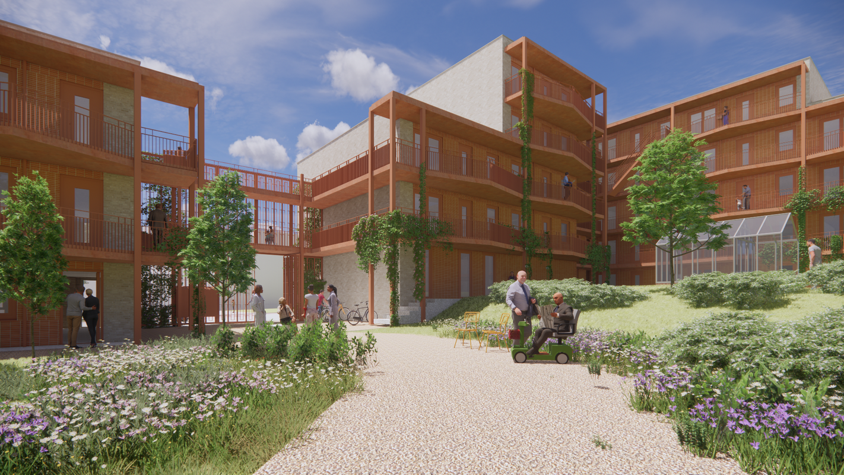
Mitigating the care gap?
No regulation:
  who gets to live there
  And for what price?
Exception: social rent
Notes:
Main reason: Developers can still make a lot of profit of this, so they are also not very opposed to it.
Problem: Municipality cannot put criteria on who the apartments are rented out to!! Unclear whether target group is reached?
Exception: social housing. Here the municipality can set criteria on who can access it and there is an income cealing. Much more difficult to get private developers to develop this, especially in contract-based planning. We observe that even when the municipality has regulations that 30% of newly developed apartments should be in the social rent, developers can usually negotiate better deals for themselves.

Slide 14
Mitigating the care gap?
Entrepreneurial municipal strategies
Commodification of care
Notes:
And so, to answer the question whether this approach mitigates the care gap, we do not think so. due to decentralization of care responsibilities, municipalities are basically forced to engage in these entrepreneurial strategies in order to effectively and efficiently achieve their planning objectives. Entrepreneurial municipal planning strategies lead to issues with regulating the affordability of such age-appropriate housing, and thus the Exclusion of elderly, especially low-income. Furthermore, elderly are still dependent on arranging care for themselves, and in a highly individualized society, this usually means that they are dependent on private care providers, which leads to further commodification of care, only available to those who have enough money to pay for it.

Slide 15


Josje Bouwmeester
PhD candidate at University of Bern, Institute of Geography, Bern Switzerland
@: josje.bouwmeester@unibe.ch
www.goverdense.org
Notes:
Thank you very much, my contact info, happy to hear your comments, thoughts about paralels/differences in your country.

