Slide 1
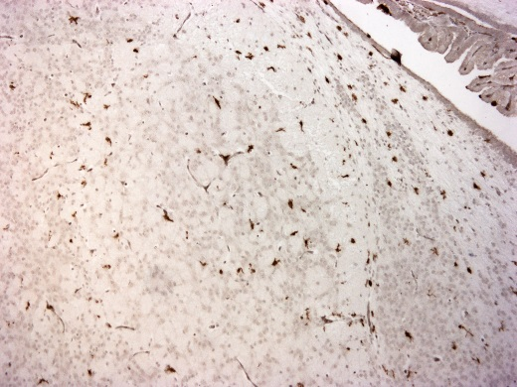
Healthy
Injury
Injury + Exo
n.s.
n.s.
Hippo-campus
Healthy
Injury
Injury + Exo
n.s.
n.s.
Thalamus
Healthy
Injury
Injury + Exo
n.s.
n.s.
Cortex
Healthy
Injury
Injury + Exo
Figure S1. Microgliosis in gray matter areas after perinatal brain injury. Representative chromogenic immunohistochemistry images and quantification of Iba1⁺ cells in the hippocampus, the thalamus and the cortex of healthy rats and of rats 24 hours post brain injury with and without exosome treatment.

